Slide 1

IOT: Smart Plant Pot
-Lê Đức Anh Toàn
-Trịnh Phạm Phú Quang
-Nguyễn Hoàng Nguyên Khải
Final Report

Slide 2
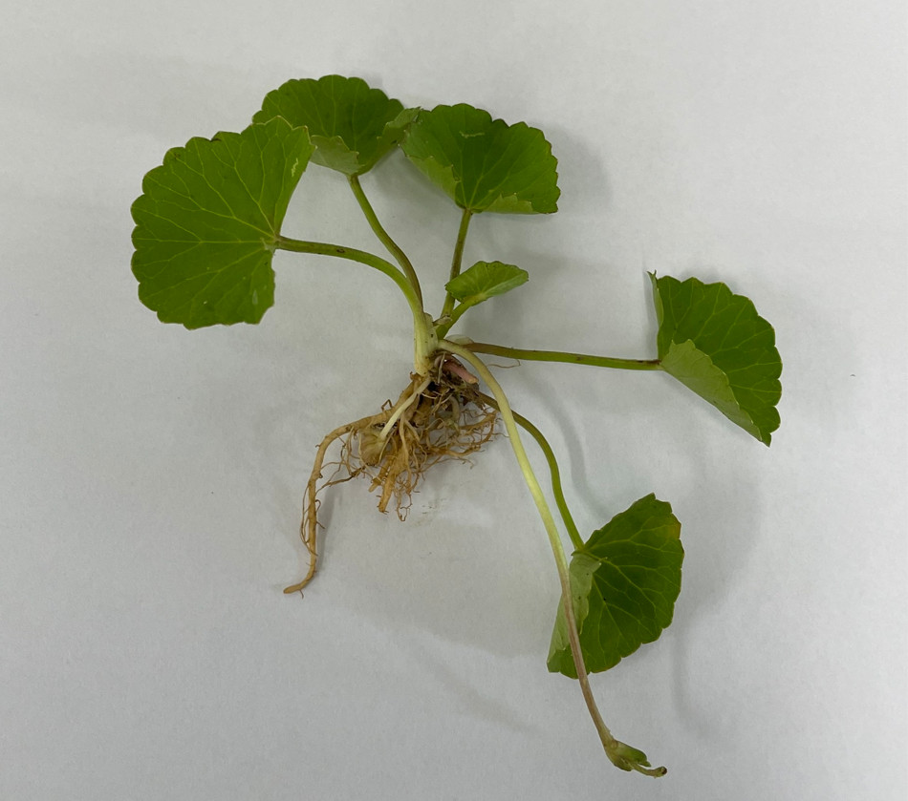
About us and our project
What can our project do:
Detect moisture level in the soil
Self-Water based on the moisture detected
Runs on batteries
Energy and Water Cost-Efficient
Runs even if the house’s power is out
Only have to replace battery every few months
We use Cây Rau Má

Slide 3
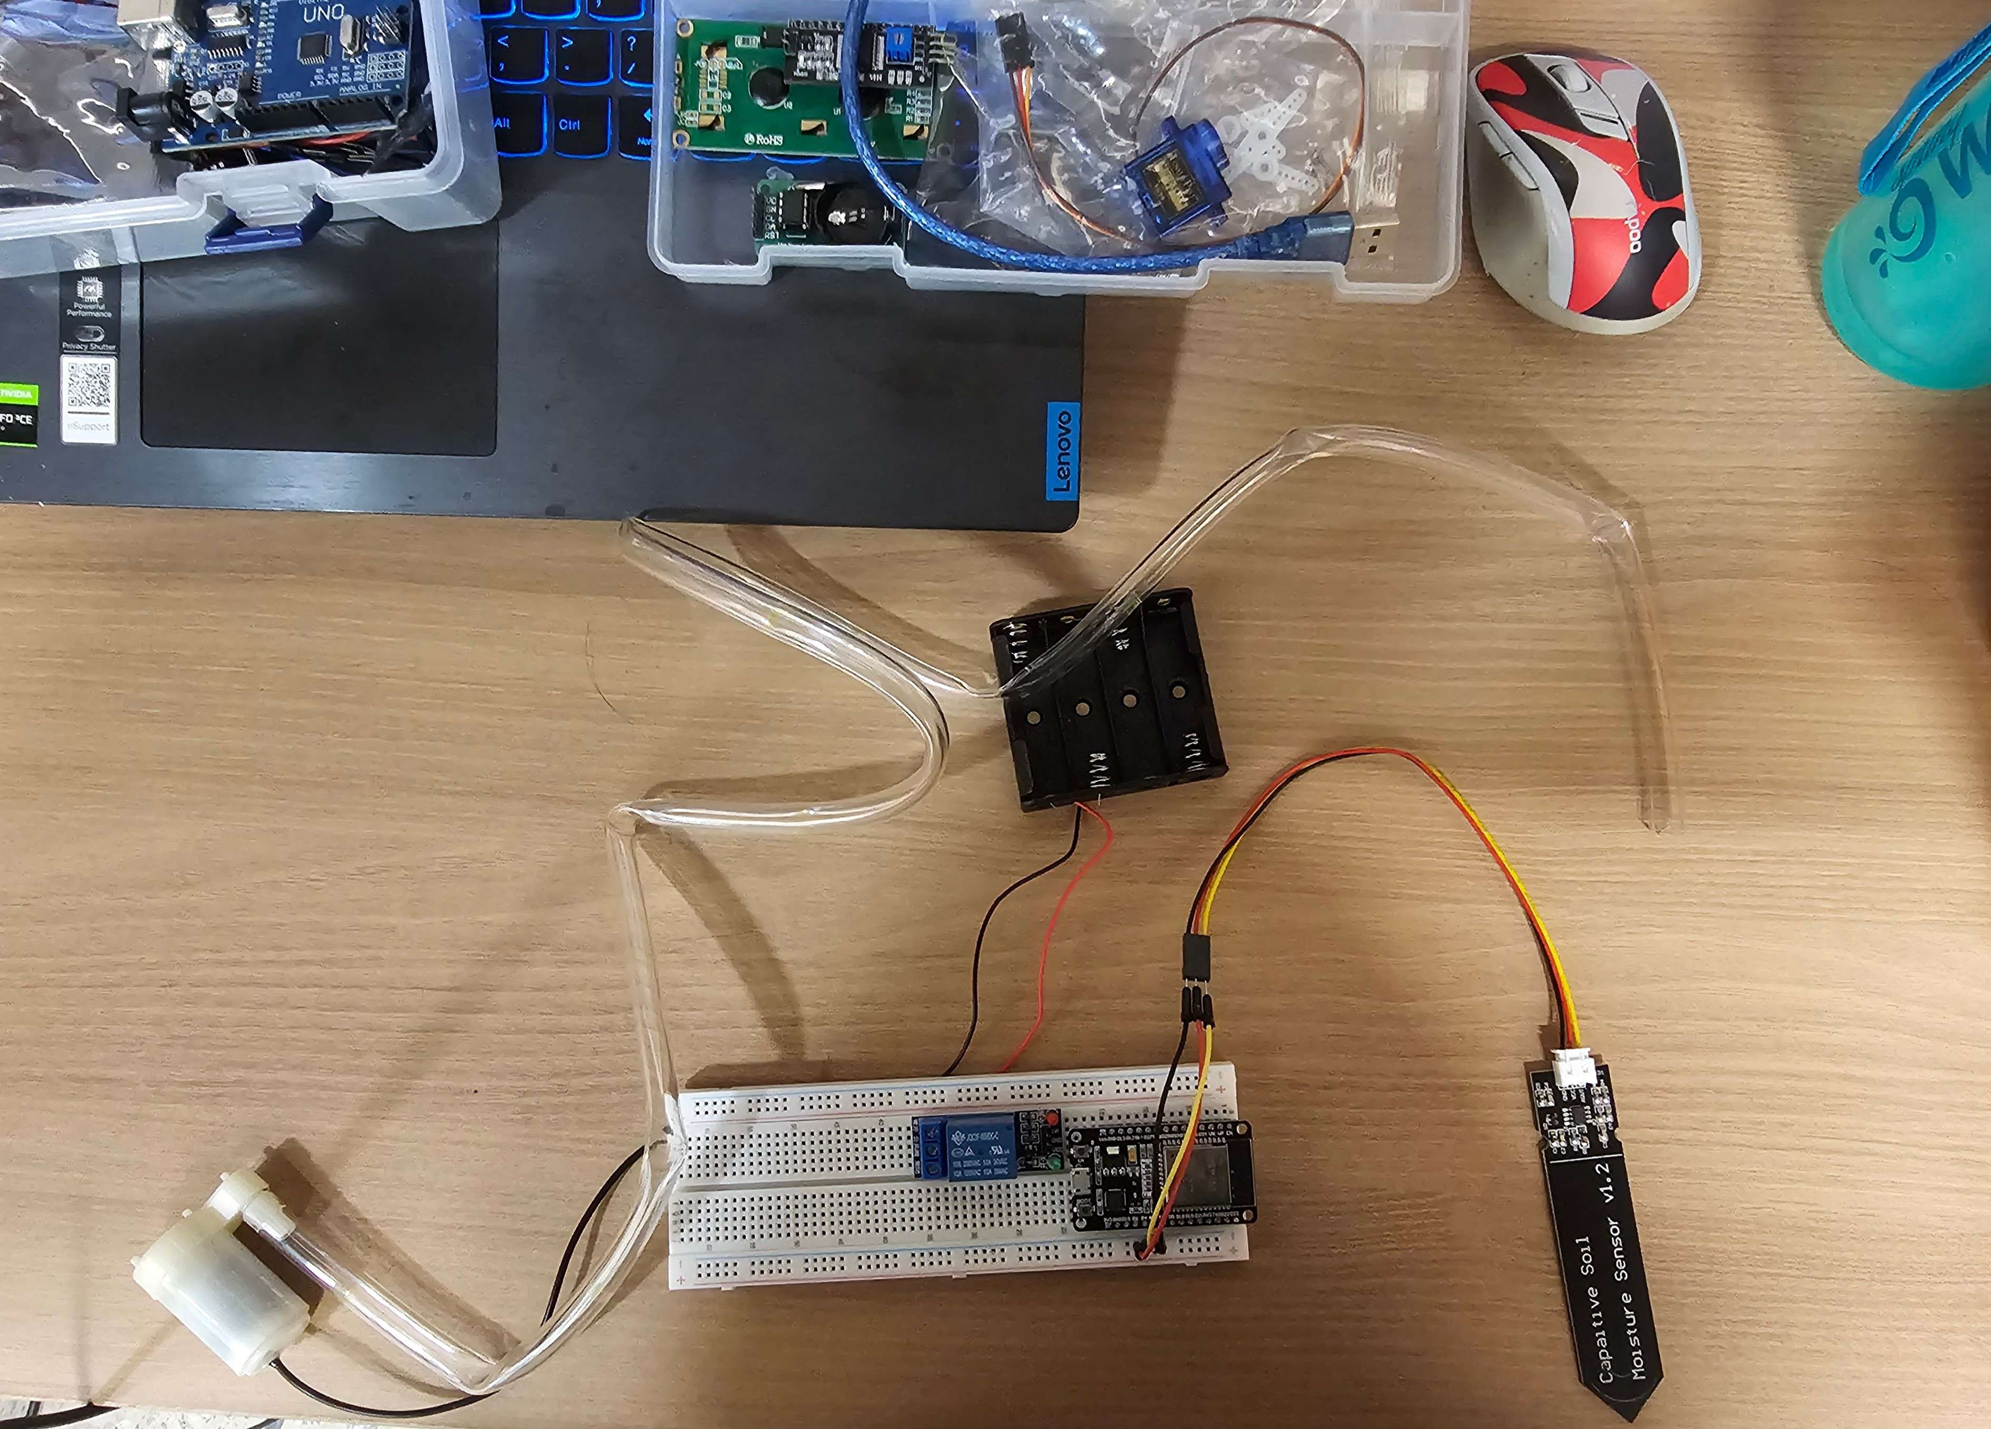
Hardware:
ESP 32
Soil Moisture Sensor
1 Channel Relay Module
Mini Pump
Plastic Pipe (1 meter)
Small Battery Box + 4 AA battery(6V)

Slide 4
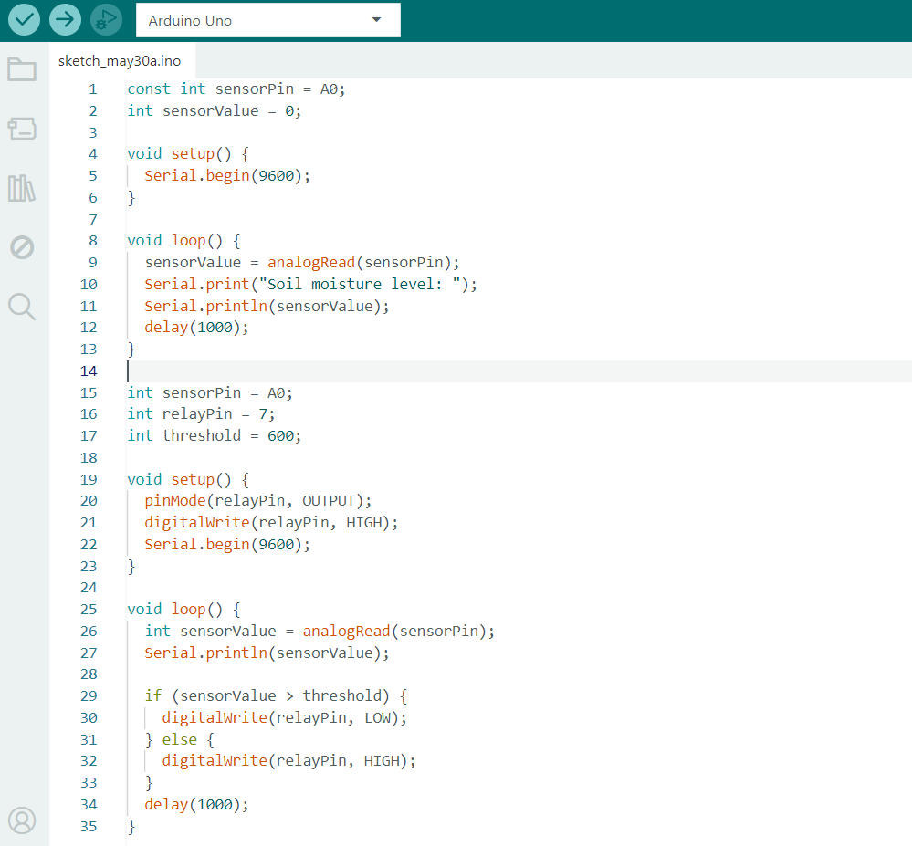
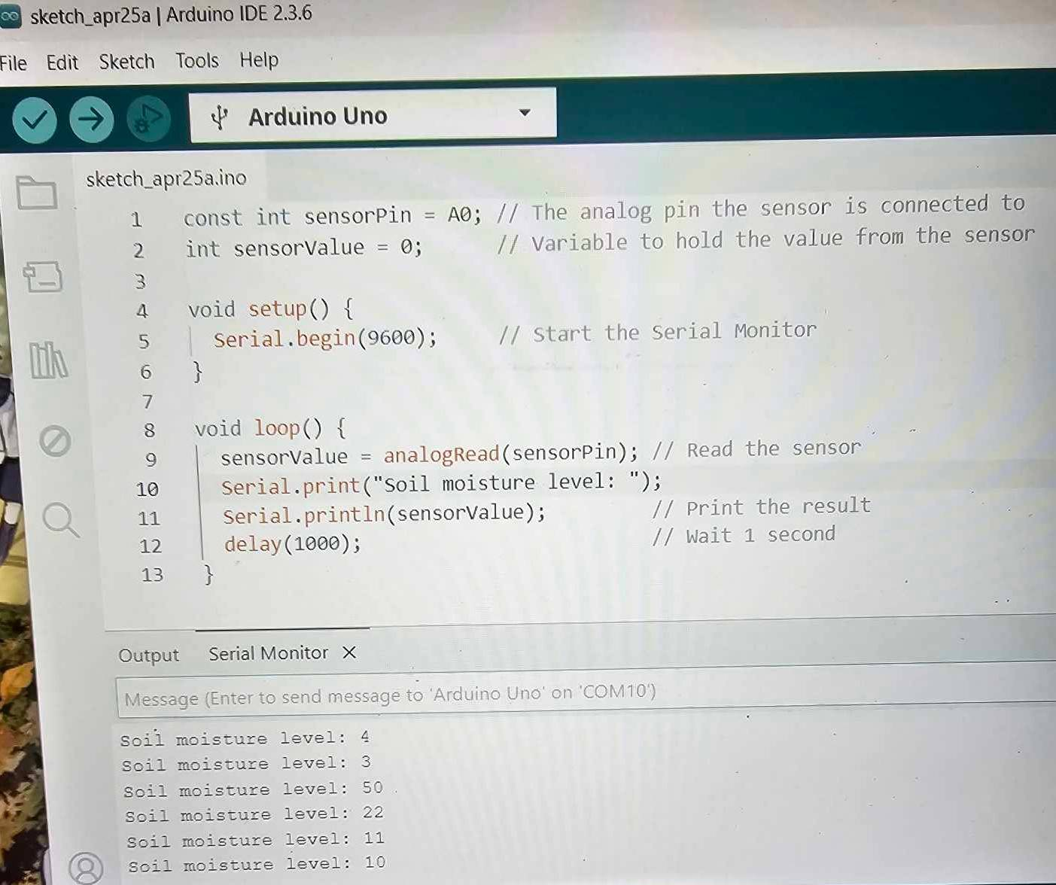
Code:
BEFORE
Arduino Uno

Slide 5
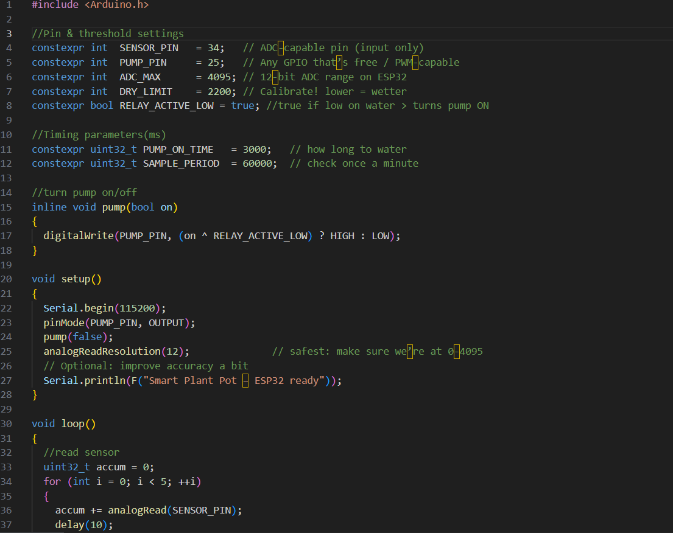
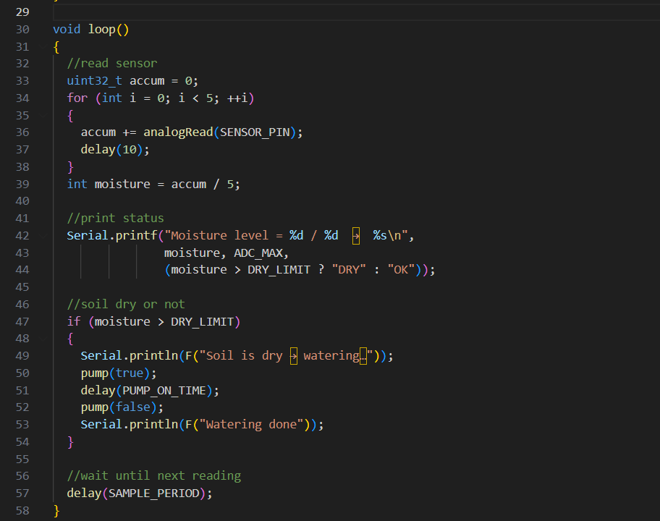
Code:
AFTER
ESP 32

Slide 6
Why?
Encourage people to start keeping a pet plant
Give them a sense of responsibility
Reduce Stress
Improve Air Quality
Low-Cost and Low-Maintenance required

Slide 7
Thank you for listening
References:
https://github.com/microsoft/IoT-For-Beginners/tree/main
https://pyimagesearch.com/2021/04/12/opencv-haar-cascades/
https://gisgeography.com/ndvi-normalized-difference-vegetation-index/
https://forum.arduino.cc/t/connect-a-6v-battery-to-the-vin-port/1047992

